Slide 1
Phase Changes

Slide 2
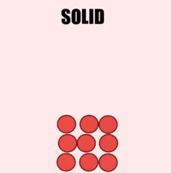
In this Smart Lesson you will learn to:
Recall the 3 main states of matter and the processes involved in changing state.
Explain why the temperature of the system remains the same during the process of state change.
Apply understanding of internal energy and the kinetic particle model of matter to describe changes of state.

Slide 3

Solids have a definite shape and volume.
This means that, regardless of what container they are in, they:
have the same shape, and
occupy the same area.

Slide 4
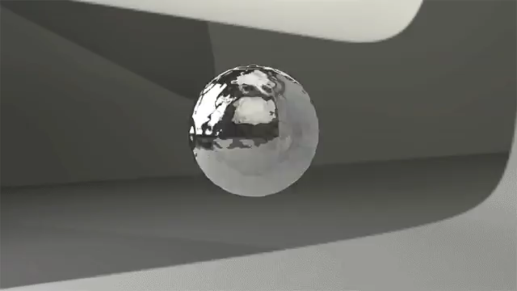
Liquids have a variable shape but definite volume.
This means they will change their shape to fit different containers.
However, they will still occupy the same amount of space.

Slide 5
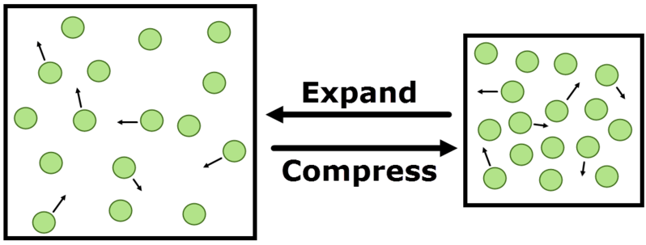
Gases have variable shape and volume.
This means they will change their shape and the space they occupy to fill a container.
Gases will expand (grow) when moved to a larger container and compress (shrink) when moved to a smaller container.
They are thus expandable and compressible.

Slide 6
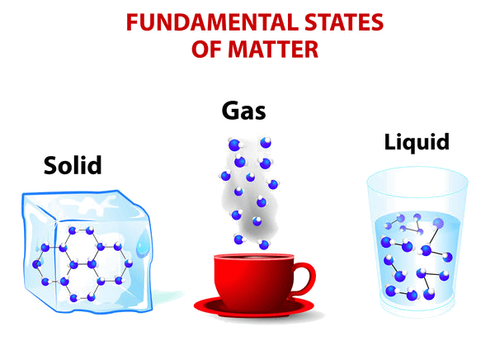
Energy in solids, liquids and gases.
Particles in solids have low kinetic energy. The particles are tightly bound, so can't move much, giving them a smaller kinetic energy.
Particles in liquids have a moderate amount of kinetic energy. This is because the particles can move more, giving them a greater kinetic energy.
Particles in gases have highest kinetic energy as the particles are moving quickly. In an ideal gas, there are no intermolecular forces. However, in a real gas there are weak intermolecular forces.

Slide 7
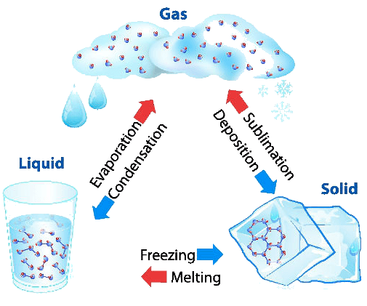
You should be familiar with the state changes below.
Changes of state require energy to be added to or removed from a system.
Melting and vaporisation both require an energy input. Condensation and solidification both require energy to be removed from the system.

Slide 8
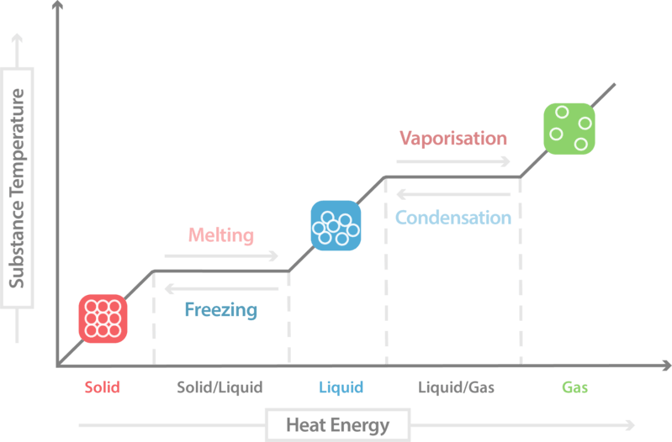
A substance changing stages is known as a phase change.
When a substance, such as ice, is heated, its temperature will increase. However, once we add enough energy that the ice melts (in other words, it undergoes a phase change), the temperature of the substance stops increasing. You can see these temperature plateaus in phase change diagrams like the one below:

Slide 9
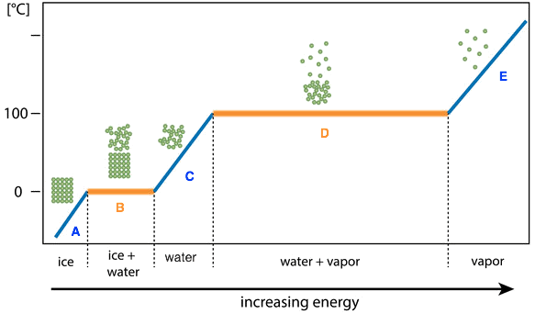
Latent heat is the energy that is absorbed or released during a phase change. It is called latent heat because it is concealed (hidden).
The temperature of a system remains the same during the process of state change. The energy being added to or removed from the system during a phase change is being used to break or form intermolecular bonds.

Slide 10
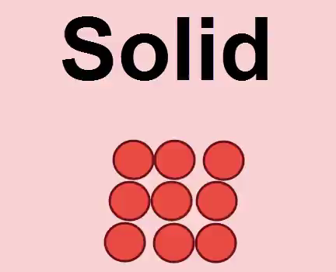
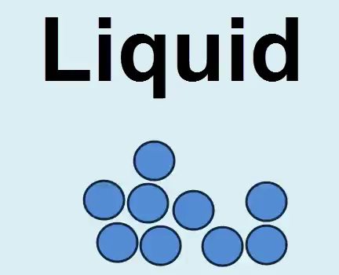
Melting
A solid is made up of particles that are packed close together and only move a tiny amount. The majority of energy in solid substances is stored in the bonds that hold the molecules together tightly.
When heat energy is added to a solid, the bonds holding the particles together begin to break. This means that the particles spread out and take on the shape of the container they are in, rather than having a fixed shape.
This means that the solid becomes a liquid. This state change is called melting.

Slide 11
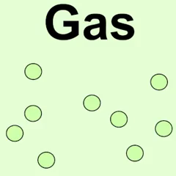
Vaporisation
A much greater amount of energy is required to convert a liquid to a gas. When heat energy is added to a liquid, the intermolecular bonds in the substance are broken.
This means that the liquid becomes a gas. This process occurs through evaporation or boiling.

Slide 12
Condensation
When we remove heat energy from a gas, the particles begin to form intermolecular bonds again, which holds the substance closer together and it stays in a smaller area.
This means that the gas becomes a liquid. This process is called condensation.

Slide 13
Solidification
When heat energy is removed from a liquid, the particles form rigid intermolecular bonds. These bonds hold the particles tightly in place.
This means that the liquid becomes a solid. This process is called solidification or freezing.

